Slide 1
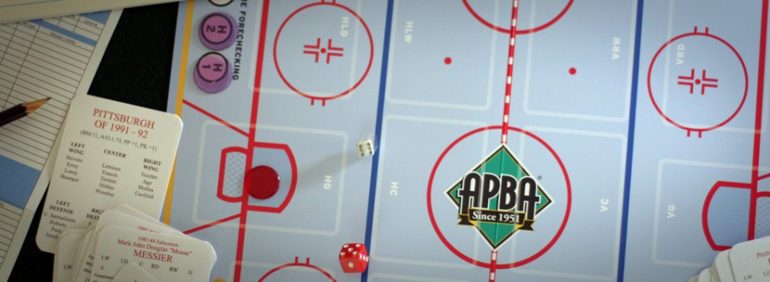
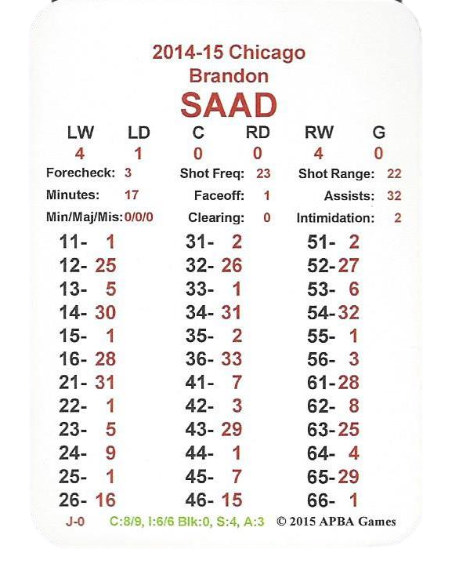
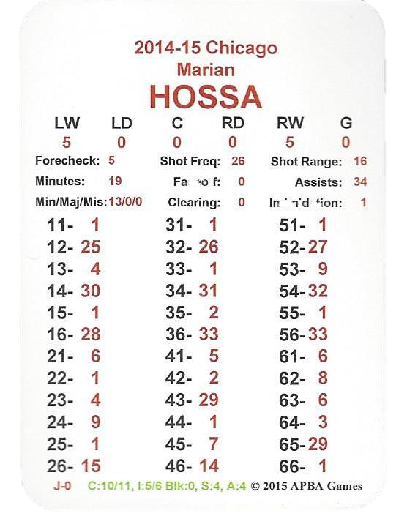
One of the most exciting features of APBA Hockey is the Matchup System.
Matchups
Notes:
Screen dimensions are 4.39 x 6.97

Slide 2
Every player is rated for Corner battles…
Matchups
Notes:
Screen dimensions are 4.39 x 6.97

Slide 3
…In the Slot battles...
Matchups
Notes:
Screen dimensions are 4.39 x 6.97

Slide 4
…shot creation ability…
Matchups
Notes:
Screen dimensions are 4.39 x 6.97

Slide 5
…as well as assists for breakaway passes.
Matchups
Notes:
Screen dimensions are 4.39 x 6.97

Slide 6
These ratings capture the feel of each player as they battle for control of the puck.
Matchups
Notes:
Screen dimensions are 4.39 x 6.97

Slide 7
Here’s how it works…
Matchups
Notes:
Screen dimensions are 4.39 x 6.97

Slide 8
Let’s go back to our earlier example of Marian Hossa scoring a goal…
Matchups
Notes:
Screen dimensions are 4.39 x 6.97

Slide 9
…in that example we rolled a “66” resulting in PRN 1 which led to a goal for Chicago.
Matchups
Notes:
Screen dimensions are 4.39 x 6.97

Slide 10
The Matchup System is triggered on dice roll “53” in Forecheck strategy 2, and all rolls of “53” and “62” for Forecheck Strategy 3.
Matchups
Notes:
Screen dimensions are 4.39 x 6.97

Slide 11
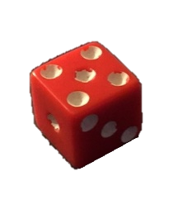
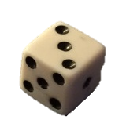
Here we go!
Matchups
Notes:
Screen dimensions are 4.39 x 6.97

Slide 12
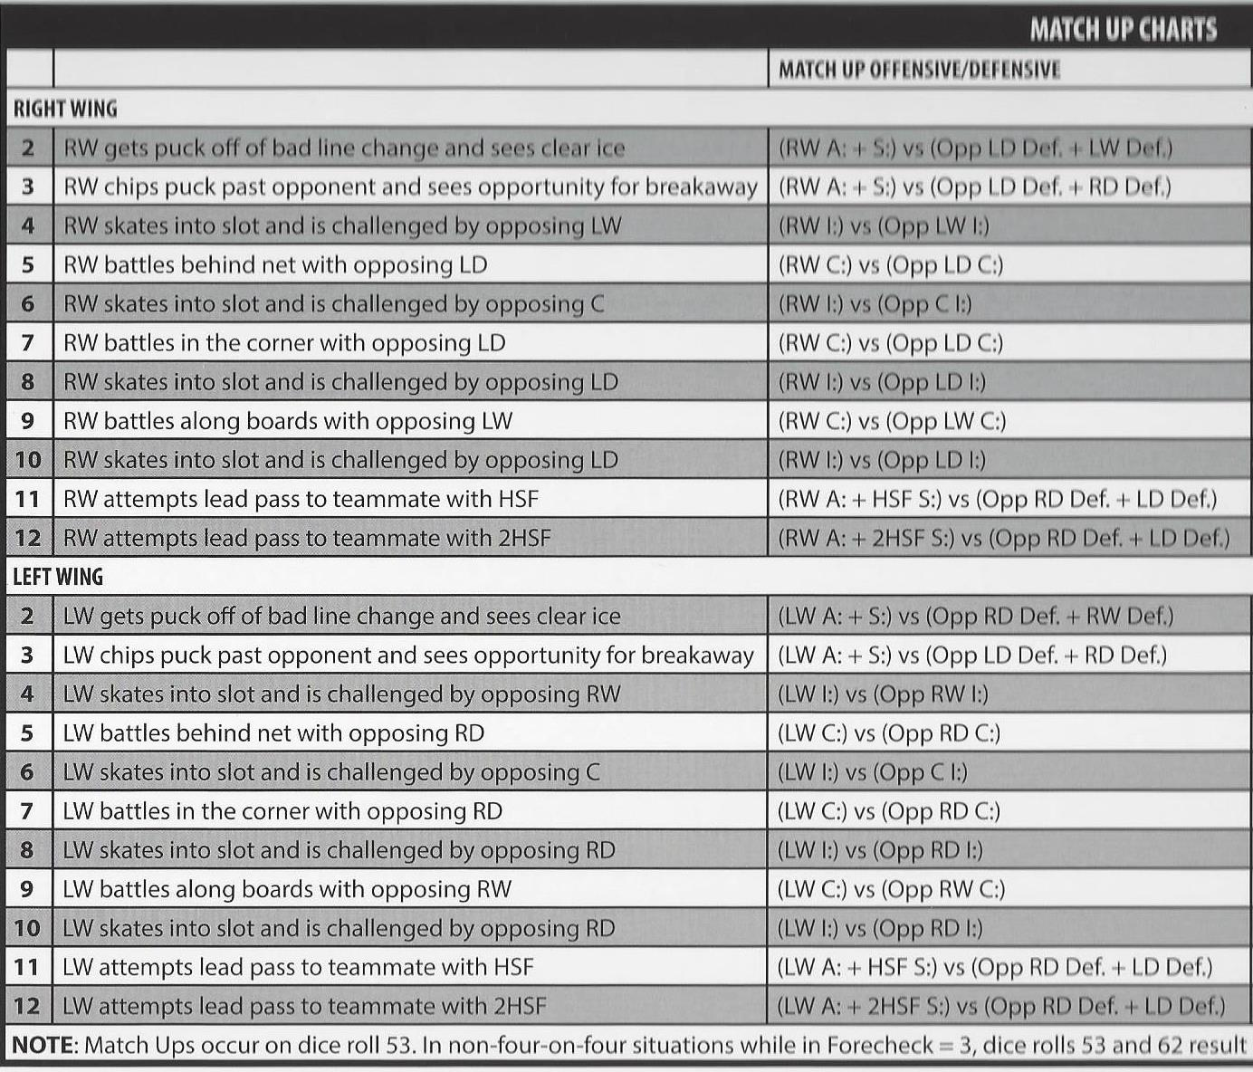
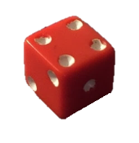
Roll the dice and add them…
Matchups
Notes:
Screen dimensions are 4.39 x 6.97

Slide 13
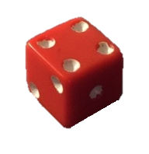
…Hossa is the right wing…
…he battles in the corner with the opposing left defenseman…
Matchups
Notes:
Screen dimensions are 4.39 x 6.97

Slide 14
…Tampa Bay’s Anton Stralman is the left defenseman…
Matchups
Notes:
Screen dimensions are 4.39 x 6.97

Slide 15
…now we’re going to compare Hossa’s and Stralman’s Corner Battle Ratings (C:)
Matchups
Notes:
Screen dimensions are 4.39 x 6.97

Slide 16
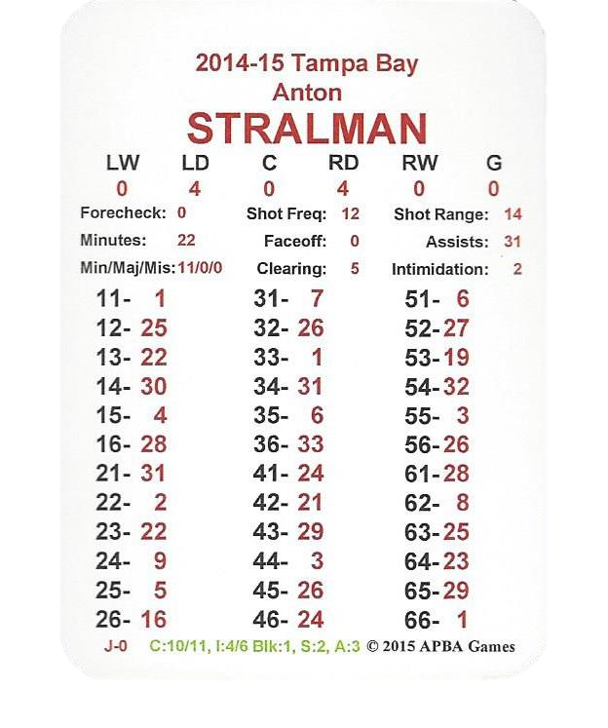
The number to the left of the slash is the offensive Corner Battle Rating…Hossa is rated a 10…
Matchups
Notes:
Screen dimensions are 4.39 x 6.97

Slide 17
The number to the right of the slash is the defensive Corner Battle rating…Stralman is rated an 11…
Matchups
Notes:
Screen dimensions are 4.39 x 6.97

Slide 18
Stralman wins the matchup!
Matchups
Notes:
Screen dimensions are 4.39 x 6.97

Slide 19
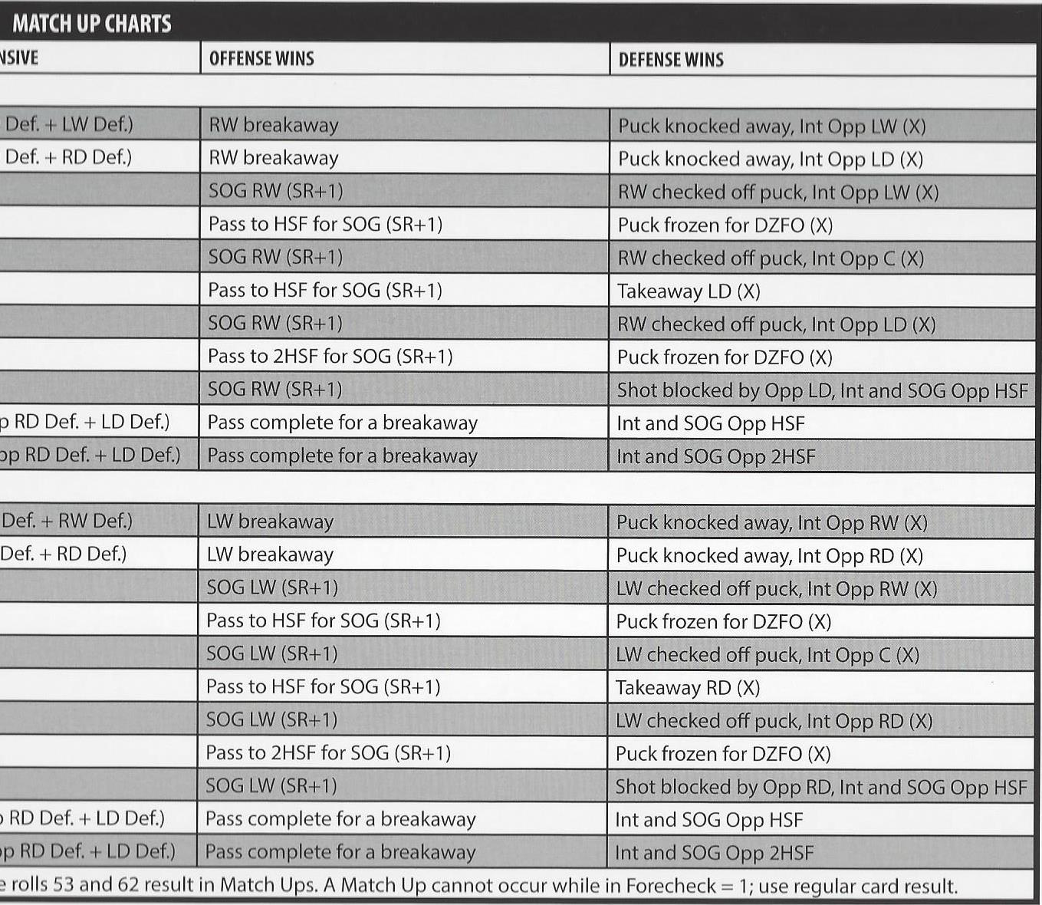
Consult the Matchup Chart under the “Defense Wins” section. Using the previous dice roll of 7 we find that the RW (Hossa) was checked off the puck and intercepted by the LD (Stralman). Mark a time sequence.
Matchups
Notes:
Screen dimensions are 4.39 x 6.97

Slide 20
Had Marian Hossa won the matchup battle, the result would have been a shot on goal for Hossa with a +1 increase to his shot range.
Matchups
Notes:
Screen dimensions are 4.39 x 6.97

Slide 21
APBA Hockey is that easy! Roll the dice, check the card for a PRN, consult the chart.
Notes:
Screen dimensions are 4.39 x 6.97

